Slide 1

Working With Data DATA9910
Week 3
Lucas Rizzo
email: lucas.rizzo@tudublin.ie

Slide 2
Indicative schedule
Week 1 | Set up environment and R notebook
Week 2 | Review Python and practice
Week 3 | Review R, importing data
Week 4 | Intro SQL and aggregate queries
Week 5 | Databases and scripting languages (To be submitted)
Week 6 | Interpreting Data (summary statistics, data visualisation)
Week 7 | Review week
Week 8 | Data manipulation in R Pandas and Numpy
Week 9 | Data visualisation in Python Data processing (regular expressions)
Week 10 | Audio data (R and tuneR) (To be submitted)
Week 11 | Image data (Python and skimage) (To be submitted)
Week 12 | Time series (Python and Pandas)
Week 13 | Working on Assignment Assignment deadline

Slide 3
Last week
Python introduction/review
Any questions?

Slide 4
Overview
Introduction to R
Data Types
Vectors
Data Frames
Importing data to R

Slide 5
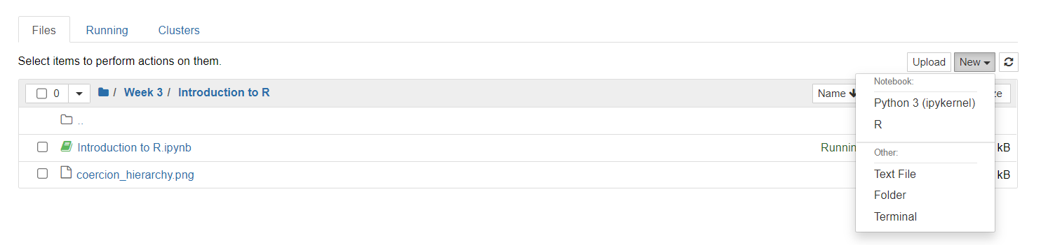
R kernel on Jupyter notebook (no Anaconda)
Open a terminal and start R or work on the R console in RStudio
Run
install.packages('IRkernel')
IRkernel::installspec()
Restart Jupyter (if running)

Slide 6
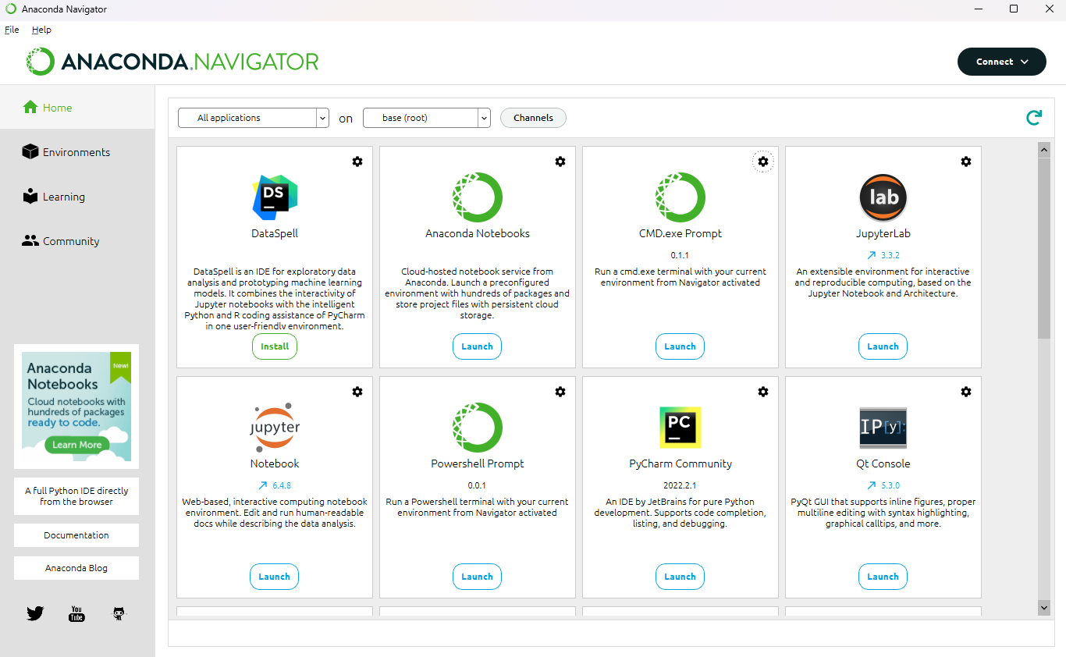
R kernel on Jupyter notebook (with Anaconda)
Open the command prompt from the navigator

Slide 7
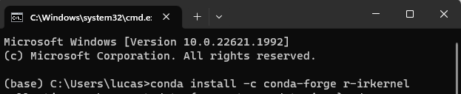
R kernel on Jupyter notebook (with Anaconda)
Run the conda install command and follow any instructions in the prompt: conda install -c conda-forge r-irkernel
Any issues check here https://anaconda.org/conda-forge/r-irkernel

Slide 8
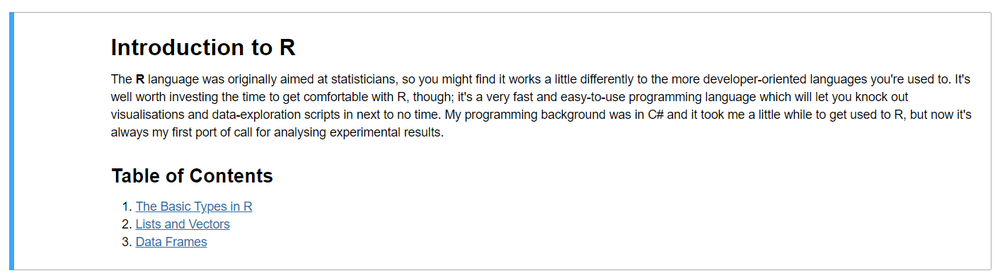
R introduction in the notebook
Review the notebook available in Brightspace

Slide 9
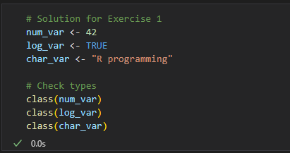
R Quizz (1)
Create three variables in R: one numeric, one logical, and one character. Check their types using the `class()` function.

Slide 10
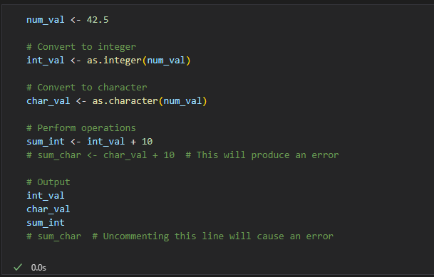
R Quizz (2)
Convert a numeric value to an integer and a character type. Observe and explain what happens when you try to perform mathematical operations on each type.

Slide 11
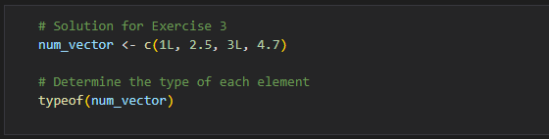
R Quizz (3)
Create a numeric vector with both integer and double values. Use the `typeof()` function to determine the type of each element in the vector.

Slide 12
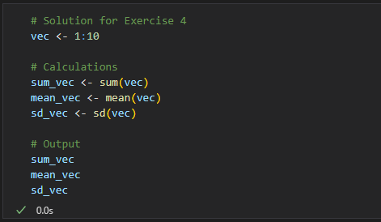
R Quizz (4)
Create a vector containing the numbers from 1 to 10. Write R code to calculate the sum, mean, and standard deviation of the vector.

Slide 13
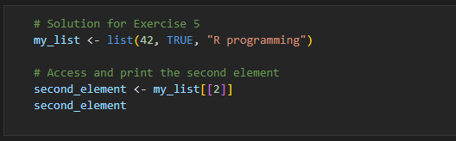
R Quizz (5)
Create a list containing at least one element of each basic data type (numeric, logical, character). Access and print the second element of the list.

Slide 14
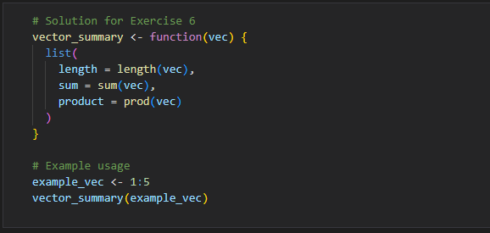
R Quizz (6)
Write a function in R that takes a vector as input and returns a list with the following components: the length of the vector, the sum of its elements, and the product of its elements.

Slide 15
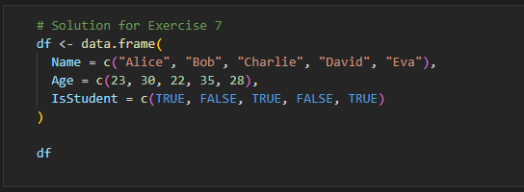
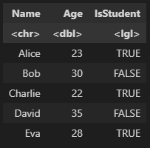
R Quizz (7)
Create a data frame with three columns: Name (character), Age (numeric), and IsStudent (logical). Add at least five rows of data.

Slide 16
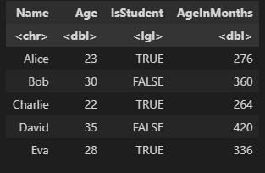
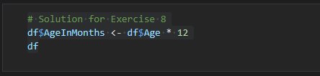
R Quizz (8)
Write R code to add a new column to the data frame created in Exercise 7, which calculates the age of each person in months.

Slide 17
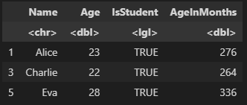
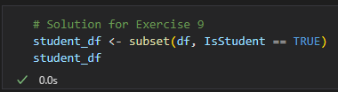
R Quizz (9)
Use the `subset()` function to filter the data frame for rows where `IsStudent` is `TRUE`.

Slide 18
Importing Data to R
Text file formats often use delimiters to separate the different elements in a line
The most common format is comma separated values (csv)
However, any character (or sequence of characters) may be used
The extension sometimes gives additional information (.tsv = tab, .csv = comma)
Lucas,Rizzo,d12345678 (comma separated)
Lucas Rizzo d12345678 (tab separated)

Slide 19
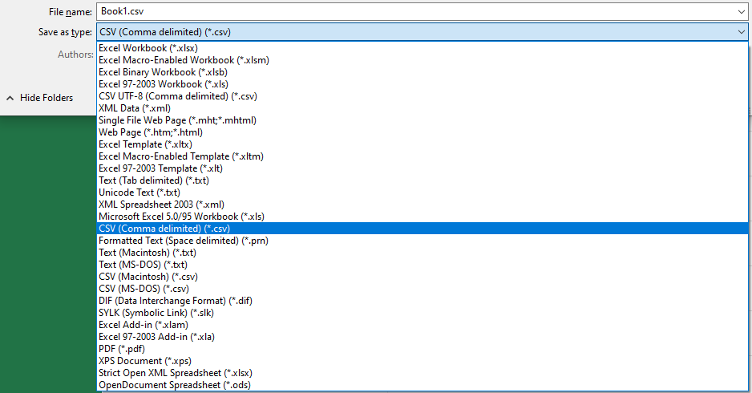
Creating CSV Files
CSV files can be created with any text editor.
If your text editor does not save as csv files, just change their extension to .csv
Applications such as Excel also allow you to create CSV files
CSV files are useful because they're portable and simple to work with

Slide 20
Locating Files on Disk
When we read or write a file in R we need to tell the interpreter where to find the file.
File paths can be relative or absolute
Absolute paths give the full path on disk
C:\Users\453526\data\data.csv or /home/453526/data/data.csv on Unix
Relative paths are relative to the path of the file reading/writing the external file
data.csv (in the same folder) or ../data.csv (one folder above)
Absolute paths should generally be avoided!
They are not portable so they won't work on someone else's machine

Slide 21
More about absolute and relative paths
Absolute paths begin with a drive letter (e.g. C:\ on windows) or a slash on Unix
Relative paths tell the interpreter how to find a file relative to the current working directory
The current working directory is usually the directory in which the script resides
You can check and set the current working directory using the getwd() and setwd() functions in R.
The dir() function will show all the files in the current working directory

Slide 22
Dataset
To exemplify R options to import data we are going to use the Iris dataset with some small modifications
This famous iris data set gives the measurements in centimeters of the variables sepal length and width and petal length and width, respectively, for 50 flowers from each of 3 species of iris. The species are Iris setosa, versicolor, and virginica.

Slide 23
Reading Delimited Files in Base R
R provides the read.table() function to read delimited files
Notice that the path is relative, this means it will look for the file in the current working directory
The sep parameter tells R which character is used to delimit the data
iris <- read.table("iris.csv", sep = ",")
path to file
separator

Slide 24
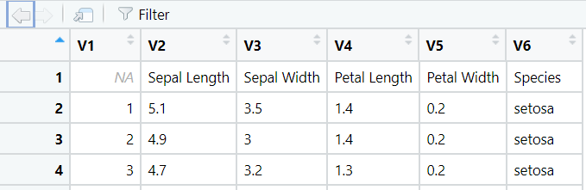
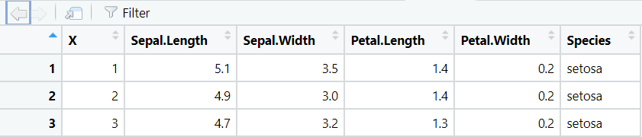
read.table()
Many arguments can be passed. Read the documentation
For example, the default behaviour of read.table is to not import the first column as header
iris <- read.table("iris.csv", sep = ",", header = TRUE)
Spaces are replaced by dots

Slide 25
Inspecting a Data Frame
It's always a good idea to inspect a data frame after you have imported it to make sure it looks as you would expect it to.
The str() function (short for structure) is an easy way to get a summary of a data frame structure.
> iris <- read.table("iris.csv", sep = ",", header = TRUE)
> str(iris)
'data.frame': 150 obs. of 6 variables:
$ X : int 1 2 3 4 5 6 7 8 9 10 ...
$ Sepal.Length : num 5.1 4.9 4.7 4.6 5 5.4 4.6 5 4.4 4.9 ...
$ Sepal.Width : num 3.5 3 3.2 3.1 3.6 3.9 3.4 3.4 2.9 3.1 ...
$ Petal.Length : num 1.4 1.4 1.3 1.5 1.4 1.7 1.4 1.5 1.4 1.5 ...
$ Petal.Width : num 0.2 0.2 0.2 0.2 0.2 0.4 0.3 0.2 0.2 0.1 ...
$ Species : chr "setosa" "setosa" "setosa" "setosa" ...

Slide 26
Automatic Type Conversions
Notice that the Species column has been imported as a character type
We can convert strings to factors with the stringsAsFactors parameter
> iris <- read.table("iris.csv", sep = ",", header = TRUE, stringsAsFactors = TRUE)
> str(iris)
'data.frame': 150 obs. of 6 variables:
$ X : int 1 2 3 4 5 6 7 8 9 10 ...
$ Sepal.Length : num 5.1 4.9 4.7 4.6 5 5.4 4.6 5 4.4 4.9 ...
$ Sepal.Width : num 3.5 3 3.2 3.1 3.6 3.9 3.4 3.4 2.9 3.1 ...
$ Petal.Length : num 1.4 1.4 1.3 1.5 1.4 1.7 1.4 1.5 1.4 1.5 ...
$ Petal.Width : num 0.2 0.2 0.2 0.2 0.2 0.4 0.3 0.2 0.2 0.1 ...
$ Species : Factor w/ 3 levels "setosa","versicolor",..: 1 1 1 1 1 1 1 1 1 1 ...

Slide 27
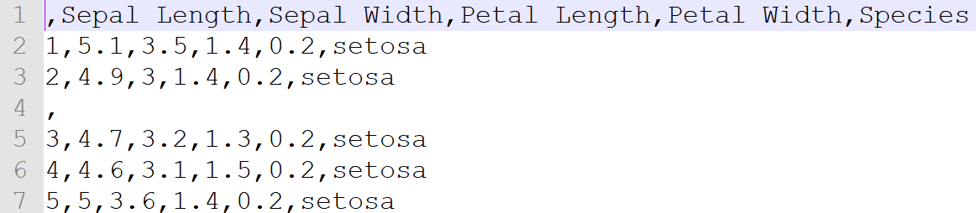
Handling missing data when importing
Missing values can cause problems when importing a dataset
Consider the following data with missing values on the 4th line
When importing it...
Empty row

Slide 28

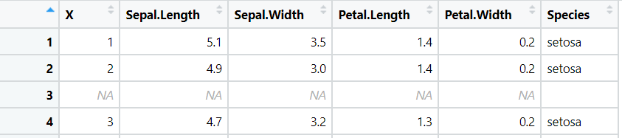
Handling missing data when importing
read.table() can automatically replace missing values with NAs
The fill parameter lets us instruct R to fill in missing values

Slide 29
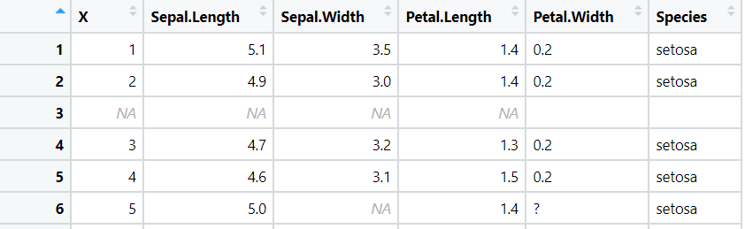
Handling missing data when importing
If we look further at the imported file, we can see that we have inconsistent ways of expressing missing data
Some values are blank, one value is a question mark and some have been replaced with NA

Slide 30
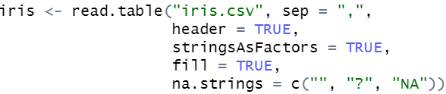
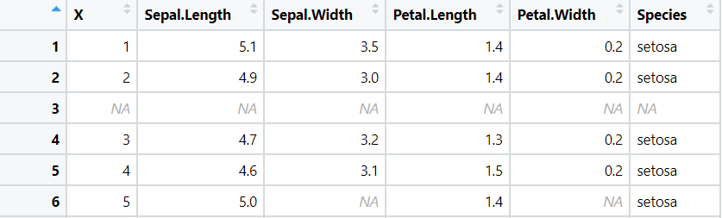
Handling missing data when importing
This can be can fixed using the na.strings parameter.
na.strings allows us to give a list of values that should be interpreted as NA

Slide 31
Similar importing functions
The read.csv and read.delim functions are exactly the same as read.table but they have some different defaults
Using these functions where applicable helps reduce clutter in your code
read.table :sep = "", header = FALSE, fill = FALSE
read.csv :sep = ",", header = TRUE, fill = TRUE
read.delim :sep = "\t", header = TRUE, fill = TRUE
Check the docs for more options. In Jupyter or RStudio you can run ?read.table to straight to the documentation.

Slide 32
The Readr Package
The readr package provides the same functionality as the read.<format> functions
It has some advantages over the base implementation
They are typically much faster (~10x)
Long running jobs have a progress bar, so you can see what’s happening.
They produce tibbles. Tibbles are data frames, but they tweak some older behaviours to make life a little easier, mainly printing and subsetting.

Slide 33

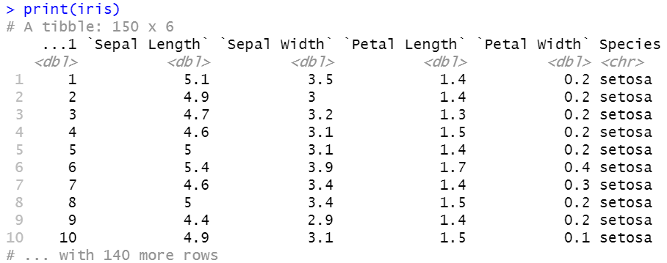
Reading CSVs with readr
The readr function read_csv is the analogue to R's read.csv function

Slide 34

Viewing Import Problems with readr
When we import data with read_csv we get a tibble
You can use the problems() function on this tibble to view any import issues that were encountered
No problems in this case =)

Slide 35
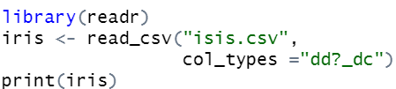
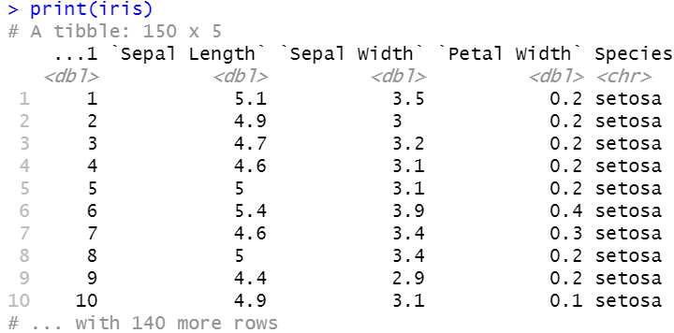
readr column specifications
The read_csv function also allows to specify column types during the import
Available column specifications
The available specifications are: (with string abbreviations in brackets)
col_logical() [l], containing only T, F, TRUE or FALSE.
col_integer() [i], integers.
col_double() [d], doubles.
col_character() [c], everything else.
col_factor(levels, ordered) [f], a fixed set of values.
col_date(format = "") [D]: with the locale’s date_format.
col_time(format = "") [t]: with the locale’s time_format.
col_datetime(format = "") [T]: ISO8601 date times
col_number() [n], numbers containing the grouping_mark
col_skip() [_, -], don’t import this column.
col_guess() [?], parse using the “best” type based on the input.

Slide 36
Other Functions in readr
Readr supports seven file formats with seven read_ functions:
read_csv(): comma separated (CSV) files
read_tsv(): tab separated files
read_delim(): general delimited files
read_fwf(): fixed width files
read_table(): tabular files where columns are separated by white-space.
read_log(): web log files
You can find out more about these functions by reading the docs

Slide 37
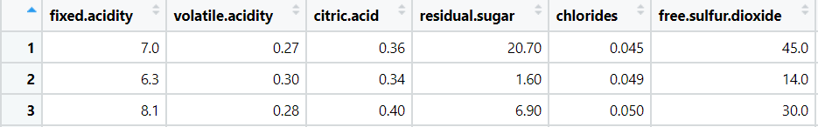
Reading CSVs from the Web
The most straightforward way to get data from the web in R is to read a csv from a URL.
If we give read.csv a URL rather than a file path it will handle it for us
url <- "https://archive.ics.uci.edu/ml/machine-learning-databases/
wine-quality/winequality-white.csv"
whineQualityWhite <- read.csv(url, sep = ";")
View(whineQualityWhite)

Slide 38
Working with Zipped Files
Large data is often compressed when stored online (e.g. zip files)
You can import a zip file using the following procedure
Download the file using the Base R function download.file
Unzip the file using the unzip function
Query the contents of the file using the list.files function
Read in the desired file to R
url <- "https://archive.ics.uci.edu/static/public/602/dry+bean+dataset.zip"
download.file(url = url, destfile = "my_file.zip")
unzip("my_file.zip")
list.files(path = "./DryBeanDataset")
Destination file in the current working directory
Unzip in the current working directory
List files in the path

Slide 39
Working with Zipped Files
> url <- "https://archive.ics.uci.edu/static/public/602/dry+bean+dataset.zip"
> download.file(url = url, destfile = "my_file.zip")
> unzip("my_file.zip")
> list.files(path = "./DryBeanDataset") [1] "Dry_Bean_Dataset.arff" "Dry_Bean_Dataset.txt" "Dry_Bean_Dataset.xlsx"

Slide 40
Working with Zipped Files
> url <- "https://archive.ics.uci.edu/static/public/602/dry+bean+dataset.zip"
> download.file(url = url, destfile = "my_file.zip")
> unzip("my_file.zip")
> list.files(path = "./DryBeanDataset") [1] "Dry_Bean_Dataset.arff" "Dry_Bean_Dataset.txt" "Dry_Bean_Dataset.xlsx"
Uncommon data type that includes additional metadata that describes the dataset's attributes

Slide 41
Working with Zipped Files
> url <- "https://archive.ics.uci.edu/static/public/602/dry+bean+dataset.zip"
> download.file(url = url, destfile = "my_file.zip")
> unzip("my_file.zip")
> list.files(path = "./DryBeanDataset") [1] "Dry_Bean_Dataset.arff" "Dry_Bean_Dataset.txt" "Dry_Bean_Dataset.xlsx"
library(readxl)
# Read the first sheet of the Excel file
data <- read_excel("./DryBeanDataset/Dry_Bean_Dataset.xlsx", sheet = 1)
View(data)
Package able to read xlsx files

Slide 42
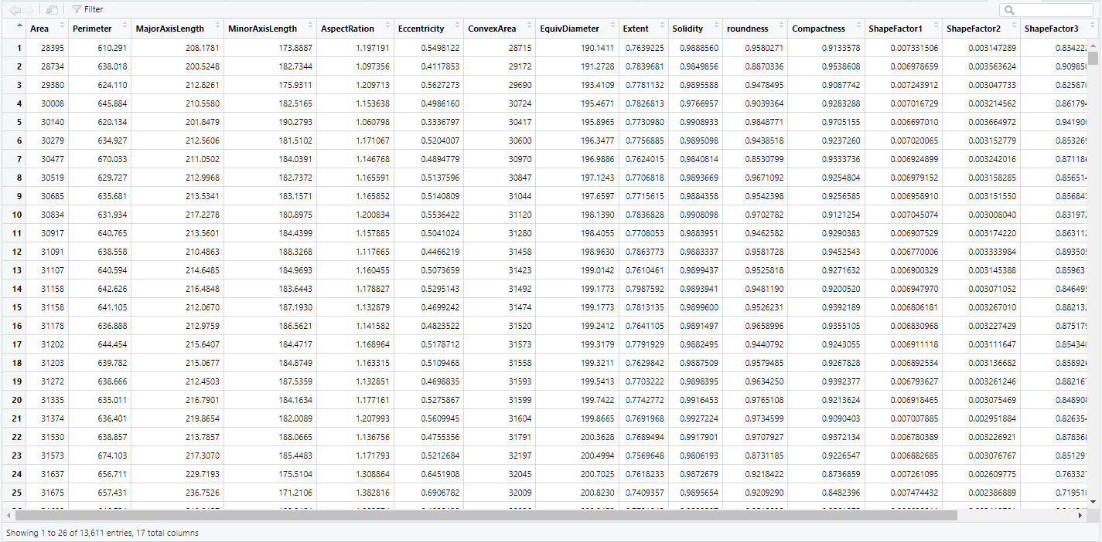
Working with Zipped Files
Dry_Bean_Dataset

Slide 43
Scraping Data
Data Scraping is how we refer to retrieving data from the internet
Being able to scrape data is a very important part of working with data
This is often how new datasets are created!

Slide 44
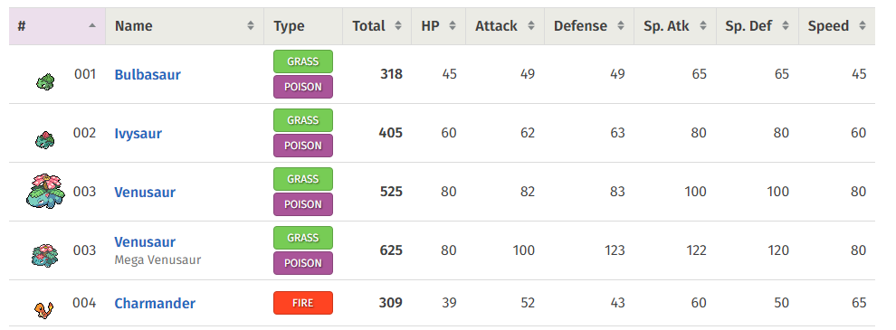
Scraping HTML Tables
Data is often displayed online in HTML tables
The rvest package can be used to import tables into R and store them as a dataframe

Slide 45
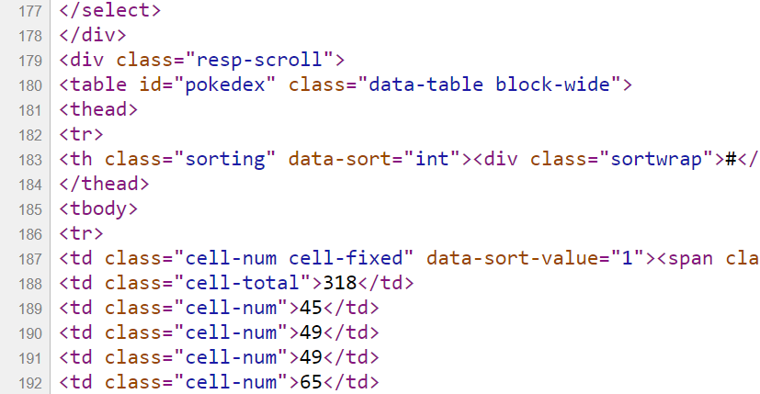
Scraping HTML tables
The first step is to fetch the HTML of the webpage. This can be done using the read_html function
The next step is to identify the tables within the code
library(rvest)
webpage <- read_html("https://pokemondb.net/pokedex/all")

Slide 46
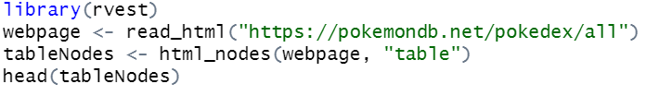
Scraping HTML tables
The function html_nodes identifies all HTML nodes in the webpage object that match the <table> tag.
It looks for tables in the webpage's structure and stores them in tableNodes.

Slide 47
Scraping HTML tables
The final step is to extract the actual table(s) using the identifier(s) contained in the list:
#install.packages('rvest')
library(rvest)
webpage <- read_html("https://pokemondb.net/pokedex/all")
tableNodes <- html_nodes(webpage, "table")
table <- html_table(tableNodes)
pokemonData <- table[[1]]
View(pokemonData)

Slide 48
Scraping HTML tables
The final step is to extract the actual table(s) using the identifier(s) contained in the list:
#install.packages('rvest')
library(rvest)
webpage <- read_html("https://pokemondb.net/pokedex/all")
tableNodes <- html_nodes(webpage, "table")
table <- html_table(tableNodes)
pokemonData <- table[[1]]
View(pokemonData)
Converts the identified HTML table nodes into a list of data frames

Slide 49
Scraping HTML tables
The final step is to extract the actual table(s) using the identifier(s) contained in the list:
#install.packages('rvest')
library(rvest)
webpage <- read_html("https://pokemondb.net/pokedex/all")
tableNodes <- html_nodes(webpage, "table")
table <- html_table(tableNodes)
pokemonData <- table[[1]]
View(pokemonData)
Extracts the first table from the list of tables (since multiple tables may exist) and stores it in pokemonData.

Slide 50
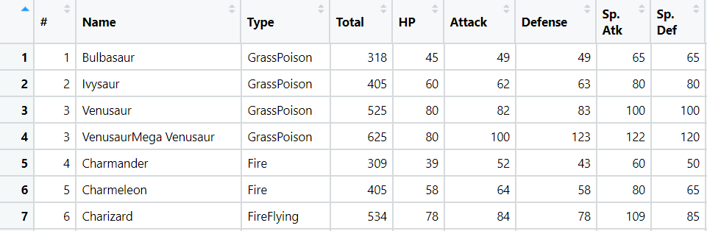
Scraping HTML tables
The final step is to extract the actual table(s) using the identifier(s) contained in the list:
#install.packages('rvest')
library(rvest)
webpage <- read_html("https://pokemondb.net/pokedex/all")
tableNodes <- html_nodes(webpage, "table")
table <- html_table(tableNodes)
pokemonData <- table[[1]]
View(pokemonData)
Opens a viewer window in RStudio to display the content of pokemonData

Slide 51
Exporting Data
After importing the data into R and carrying out some processing / computation, we may wish to permanently store our work or share it with others.
There are many different ways that this can be achieved depending on the desired format of the output.
Let’s use the pokemonData data frame, generated earlier, to explore some of the basic options available.

Slide 52
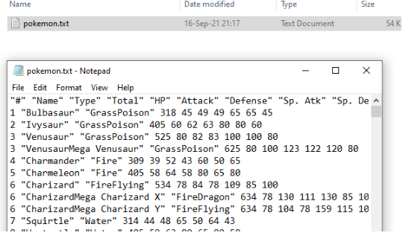
Exporting Data
The functions write.table and write.csv come built-in to R.
write.table(pokemonData, "pokemon.txt", row.names = FALSE)

Slide 53
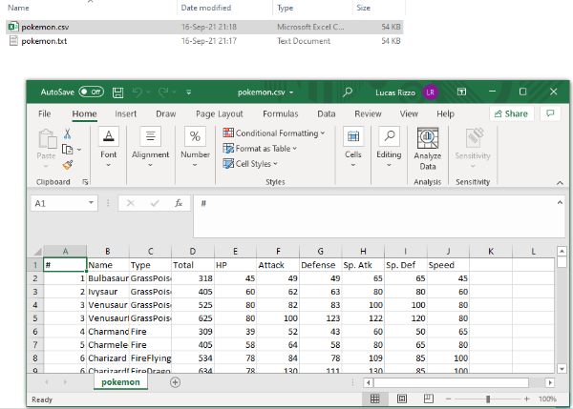
Exporting Data
The functions write.table and write.csv come built-in to R.
write.csv(pokemonData, "pokemon.csv", row.names = FALSE)

Slide 54
The RData Format
R objects can be saved using the native RData format.
An Rdata file is a binary file, whereas csv files, for example, are text files.
Advantages of Rdata format is that it is more compact, faster to read, and can store any type of R data structure. Furthermore, you can store several objects into one Rdata file.
The main disadvantage is that it is a format which is incompatible with other statistical systems or software. So you won't be able to send data in this format to someone who is not using R.

Slide 55
The RData and rds Format
The RData format is used to save multiple objects and functions present in the global environment
The .rda file is short for RData
The .rds file is suitable for saving a single R object
Base R provides the load function to import .RData/.rda files and readRDS for .rds files
The readr package offers the read_rds function for importing .rds files
load("data.RData")
readRDS("data.rds")
library(readr)
read_rds("data.rds")

Slide 56
Exporting Data
It might be better to store data in the native R format.
For example, if your dataset has one column of factors and other columns with characters, there will be no easy way to restore that metadata from a CSV.
There are two options for that
If only saving a single R object, use saveRDS {base} or write_rds {readr}.
The only major difference between the two is that write_rds() does not compress the file by default.
If saving multiple R objects, use the save function {base}, with the names of the objects collected in a character vector.

Slide 57
Exporting Data
saveRDS(pokemonData, "pokemon.rds")
write_rds(pokemonData, "pokemon_readr.rds")
name <- pokemonData$Name
type <- pokemonData$Type
save(list = c("name", "type"), file = "pokemon.RData")

Slide 58
Summary
Reading different file formats
Handling missing data when reading data
Identifying problems when reading data
Exporting and loading rds and RData formats
Scraping HTML tables

Slide 59
More DataCamp courses about R, importing data, missing values, and scraping data
Introduction to R
Intermediate R
Introduction to importing data in R
Dealing with missing data in R
Web scraping in R

Slide 60
Questions?

Slide 61
Lab
Lab 3

